Slide 1

M. KUMARASAMY COLLEGE OF ENGINEERING
MASTER OF COMPUTER APPLICATIONS
INFINITY WHEELS
GUIDED BY
Dr. S. Vanithamani MCA, M.Phil, Ph.D.
PRESENTED BY
Albin George C J(927622MCA003)
P Udhayakumar(927622MCA056)

Slide 2
ABSTRACT
The INFINITY WHEELS is a global platform that connects users with premium cars from around the world. Our platform serves as a bridge, connecting discerning buyers with exclusive premium cars that meet their preferences and expectations.
With our extensive network and comprehensive 3D scans, users can explore a wide range of high-end vehicles from the comfort of their own homes.
To ensure trust and authenticity, the system employs reliable and trustworthy agents who personally visit sellers to validate their existence and credibility. This verification process instills confidence in buyers, assuring them that the sellers are genuine and trustworthy.

Slide 3
EXISTING SYSTEM
In the current system, finding cars from other states or countries poses significant challenges for users.
The process is complex and time-consuming as individuals must navigate through various social media platforms and online marketplaces to search for potential sellers.
Contacting and physically visiting the cars for inspection becomes a cumbersome task.
Moreover, the lack of trust in sellers on social media platforms due to numerous scams further complicates the process.
Overall, the current system lacks a streamlined and trustworthy solution for customers to easily access and evaluate rare cars, while sellers struggle to reach the right audience

Slide 4
DISADVANTAGES
In the existing system, customers often face difficulties in locating their desired cars through local agents or marketplaces.
Sellers of these unique vehicles may struggle to find the right platform to effectively showcase and sell their prized possessions.
As a result, customers may need to travel significant distances to view a car that may not meet their expectations, resulting in wasted time and disappointment.
Furthermore, the presence of scams and fraudulent activities adds another layer of concern. Customers have legitimate fears of encountering dishonest sellers who may misrepresent the condition or authenticity of the cars, leading to financial losses and shattered trust.

Slide 5
PROPOSED SYSTEM
The proposed system is an innovative web-based application that establishes a centralized repository of comprehensive information related to premium car resale..
Through the system, users gain access to an extensive database of luxury vehicles, making it easy to search and explore a wide range of options.
The standout feature is the inclusion of 360-degree views, enabling users to visualize both the exterior and interior of the cars in remarkable detail.

Slide 6
ADVANTAGES
Centralized Repository
Easy Discovery
Enhanced Visualization
Trustworthy Verification
Improved Convenience Global Reach

Slide 7
SYSTEM SPECIFICATIONS
HARDWARE SPECIFICATIONS
Processor : Intel i5
RAM : 8GB
Hard Disk : 120GB
SOFTWARE SPECIFICATIONS
Operating System : Windows 8 or later / MacOS 10.10 or later / Compatible Linux distribution.
Browser : Google Chrome, Mozilla Firefox, Safari, or Microsoft Edge.

Slide 8
TECHNOLOGIES USED
Front End : HTML, CSS
Scripting Languages : JavaScript, TypeScript
Back End : Firebase Database

Slide 9
MODULE LIST
User Login
User Registration
Home Page
Car listing page
Vintage page
Car Details Page

Slide 10
MODULE LIST
User Registration
Provide a registration form where users can create an account by providing their relevant information such as name, email, and password.
Implement validation checks to ensure data integrity and security.
Store the user registration details securely in a database.
User Login
Design a login page where users can enter their credentials (email and password) to access their account.
Implement server-side validation to verify the user's login credentials.

Slide 11
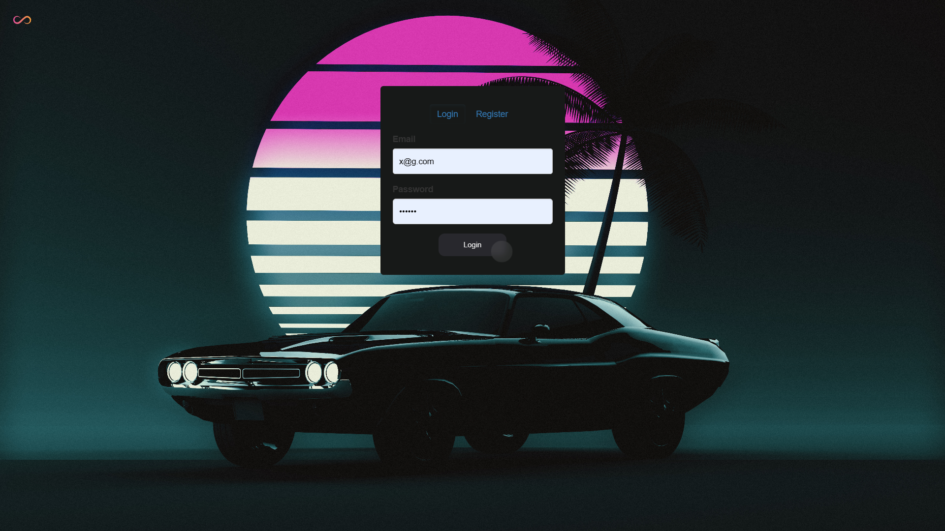
MODULE LIST
User Log in and Registration

Slide 12
MODULE LIST
Home Page
Highlight a selection of featured cars or promotional offers on the home page to attract user attention.
Our services like grading and servicing are mentioned.
Car Listing
Provides the list of cars available.
Vintage
Special place to find the classic vintage cars only

Slide 13
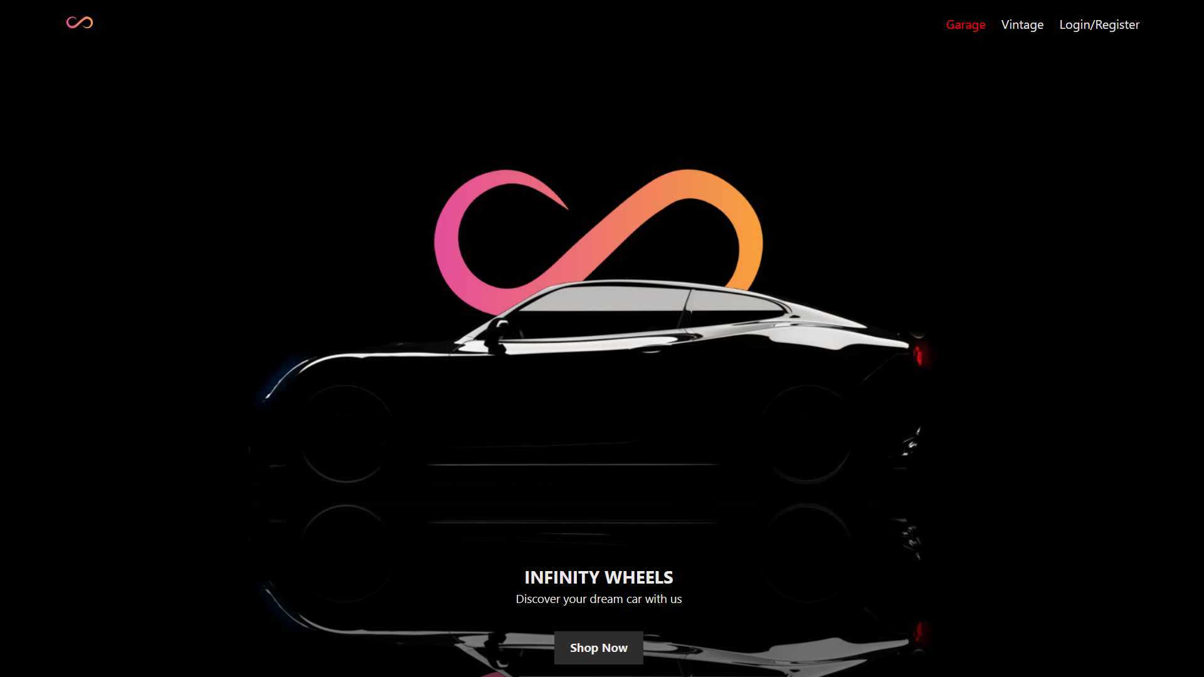
MODULE LIST
Home page module

Slide 14
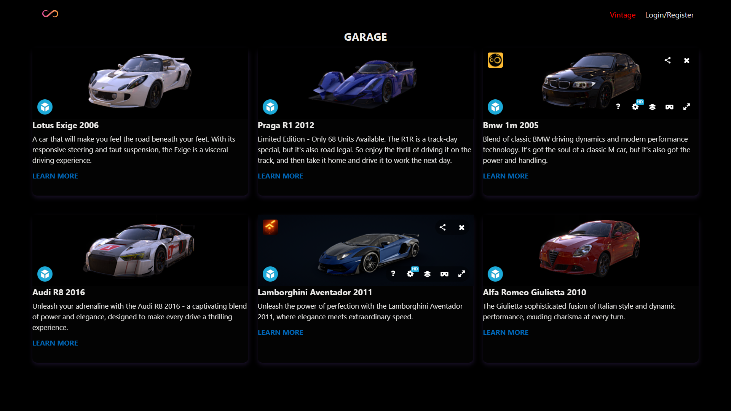
MODULE LIST
Car List module

Slide 15
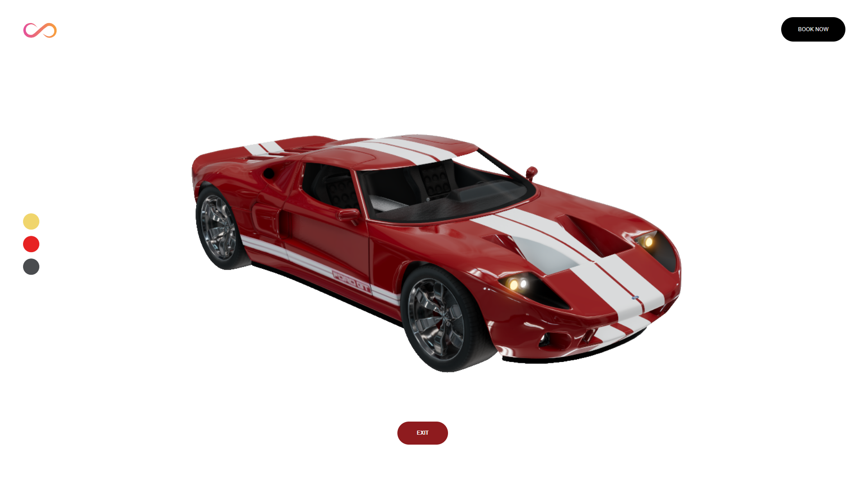
MODULE LIST
Car List module

Slide 16
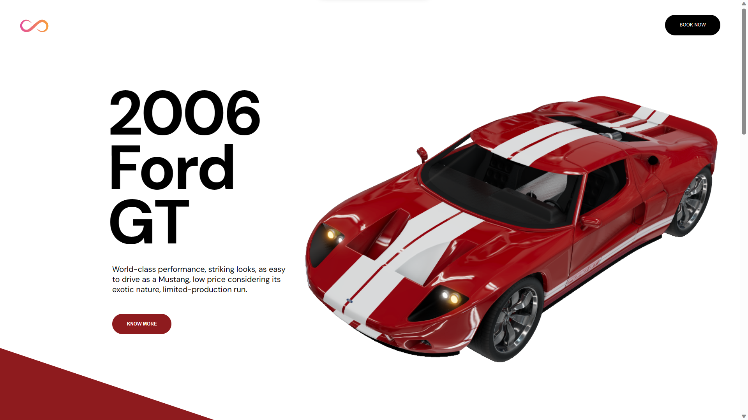
MODULE LIST
Car List module

Slide 17
OBJECTIVE OF THE PROJECT
Offer a user-friendly platform where customers can easily search for, select, and book their desired cars online, eliminating the need for physical visits to car dealerships or relying on traditional methods of car booking.
Facilitate car bookings for customers across different locations. Overcome geographical limitations and expand the availability of premium car options.
Create an intuitive and seamless user experience, ensuring that customers can navigate the website easily, access comprehensive car information, view high-quality images, and make informed decisions about their car bookings.
Establish a trustworthy and secure platform where customers can confidently book cars

Slide 18
THANKING YOU

